Slide 1


OPERATIONAL HEALTH AND CAPACITY PLANNING ANALYSIS
CASE STUDY
SIDDHANT BAJPAI
11 Nov 2024

Slide 2

OBJECTIVE:
Assess operational health, efficiency, and readiness of the processing team to support Wise’s mission of “money without borders.”
KEY AREAS:
Operational Health: Performance metrics, handling time, workload balance.
Customer Impact: Aligning team performance with Wise’s mission for transparency, speed, and convenience.
Agent Performance & Efficiency: Identify Red Flags with workload issues and decision consistency.
Capacity Planning: Projecting resources for 5x increase in TYPE_THREE Cases, maintaining January 2022 standards.
DATA SUMMARY:
Six months of records (473,316 rows) covering case reviews, associate activity, and processing decisions.

Slide 3

OPERATIONAL DATASET SUMMARY
Records: 473,316 rows (6 months)
Key Data Columns:
CASE_ID: Unique identifier for each review case, which can involve multiple Processing_IDs.
PROCESSING_ID: Primary key for individual reviews.
ACTOR_ID: Identifier for the operational associate handling each review.
CASE_TYPE: Case category, e.g., TYPE_THREE (focus for capacity planning).
OPS_DECISION: Decision outcome for each review.
Date Fields: CASE_CREATED_TIME, HANDLING_TIME_START, HANDLING_TIME_END.
Focus: While Data covers multiple case types, my analysis places particular emphasis on TYPE_THREE cases and uses Jan 2022 as the baseline for capacity planning.

Slide 4
LIBRARY | IMPORT SYNTAX | PURPOSE | NOTES
Pandas | import pandas as pd | Data filtering, grouping, workload calculations | Essential for efficient data manipulation
MatplotLib | import matplotlib.pyplot as plt | Visualizations to support insights and decisions | Clear visualizations of key metrics
Seaborn | import seaborn as sns | Advanced data visualizations | Enhanced clarity with appealing aesthetics
Numpy | import numpy as np | Calculations for workload distribution, averages | Crucial for statistical insights
PYTHON Libraries used for Data Processing & Visualization.
4

Slide 5
Step | Action | Purpose
Check Missing Values | Ops_Data.isnull().sum() Addressed missing values in critical columns | Prevents gaps in analysis by ensuring completeness, particularly in ACTOR_ID and date fields
Remove Duplicates | Removed duplicate at only 1 index=458589 Ops_Data.duplicated() | Ensures each review instance is unique, maintaining data integrity
Date Conversion | Converted CASE_CREATED_TIME, HANDLING_TIME_START, and HANDLING_TIME_END to datetime format | Enables accurate time-based calculations for handling times. Converted in seconds.
Stratified Sampling | Sampled 10% by CASE_TYPE | Maintains proportional representation of each case type while reducing dataset size
DATA Cleaning, Preparation and Sampling Strategy.
Stratified Sampling Approach:
Grouped By CASE_TYPE: Ensures balanced representation across case types.
Sampled 10% from Each Group: Allows efficient processing without compromising accuracy.
Benefits:
Representation: Reflects the true distribution of each case type in the dataset.
Performance Optimization: Reduces data size, making analysis more manageable and efficient.
5

Slide 6
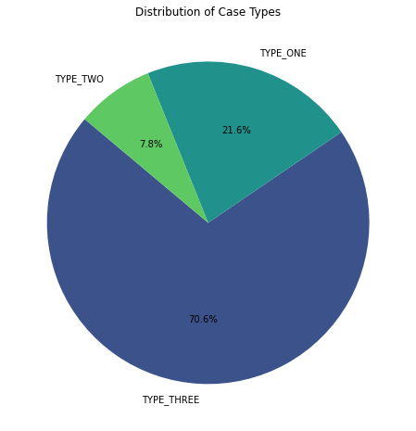
CASE TYPE DISTRIBUTION
Conclusion:
Findings:
TYPE_ONE: 70.6%
TYPE_TWO: 21.6%
TYPE_THREE: 7.8%
Interpretation: Majority of cases fall under TYPE_ONE. The analysis focuses on TYPE_THREE cases,
given the high complexity and workload demands identified in subsequent slides.

Slide 7



OPERATIONAL HEALTH ASSESSMENT
How would you rate the current operational health of the processing team?
7

Slide 8
OVERVIEW OF OPS ANALYSIS STEPS.
Metric | Description | Python Code Used | Visualization
Processing Time Metrics | Measures average handling time per case type, total handling time per associate, and variation. | avg_handling_time_case_type, total_handling_time_per_associate | Boxplot, Table
Throughput & Workload Balance | Assesses number of cases per associate to understand workload distribution. | cases_per_associate, workload_distribution | Histogram
Decision Consistency | Analyzes frequency of OPS_DECISION to evaluate decision-making uniformity. | decision_distribution | Bar Chart
Servicing and Corporate Overhead (incl. vendors)²

Slide 9
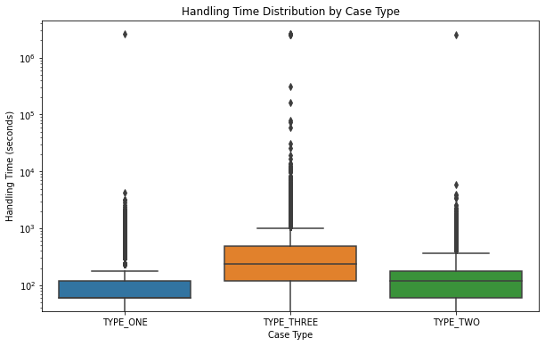
PROCESSING
TIME METRICS
HANDLING TIME VARIATION PER CASE TYPE
Case Type | Mean: Average Handling Time (sec) | Std (sec) | Min (sec) | Max (sec)
TYPE_ONE | 382 | 25638 | 0 | 2592120
TYPE_THREE | 866 | 34525 | 0 | 2660520
TYPE_TWO | 863 | 41280 | 0 | 2505660
OBJECTIVE:
Assessing variability in handling times for different case types to understand consistency and potential outliers.
INTERPRETATION:
TYPE_ONE cases have a moderate handling time.
TYPE_THREE and TYPE_TWO cases have notably higher times, indicating complexity.
Opportunities to streamline or improve processing for TYPE_THREE and TYPE_TWO cases to increase efficiency.
Notes:
Box Plot: Handling time Distribution by Case Types:- The boxplot highlight distinct differences in handling times across case types. TYPE_THREE exhibits significant variability with numerous outliers, indicating that while most cases fall within a certain time range, a subset requires exceptionally longer handling times. This could be attributed to the complexity or special requirements involved in TYPE_THREE cases, such as escalations or intensive reviews. In contrast, TYPE_ONE and TYPE_TWO show more consistency in handling times with fewer outliers, suggesting a standardized process with less variability. The high frequency of extreme outliers in TYPE_THREE underscores a potential need for targeted interventions, such as specialized training or workflow adjustments, to improve efficiency and reduce prolonged handling times in these cases.

Slide 10
PROCESSING
TIME METRICS
2. TOTAL HANDLING TIME PER ASSOCIATE
Associate ID | Total Handling Time (seconds) | Interpretation
451 | 496320 | High total time, likely indicating a heavy workload; may be at risk of burnout if not balanced.
455 | 85020 | Moderate handling time, suggesting a balanced workload for this associate.
458 | 110160 | Moderate total time, with room to take on additional cases if needed.
461 | 85140 | Similar to 455, moderate time, indicating balanced workload.
462 | 189300 | Higher workload than average; workload monitoring recommended for sustainability.
OBJECTIVE:
Assessing variability in handling times for different associates to understand consistency and potential outliers.
INTERPRETATION:
Significant variation in total handling time across associates indicates an imbalanced workload, with some associates handling much higher workloads than others.
To prevent potential burnout, consider redistributing cases or implementing workload balancing tools.
CONCLUSION:
Significant Standard Deviations and high maximum values for TYPE_TWO and TYPE_THREE indicate variability, suggesting inconsistencies in handling.
10

Slide 11
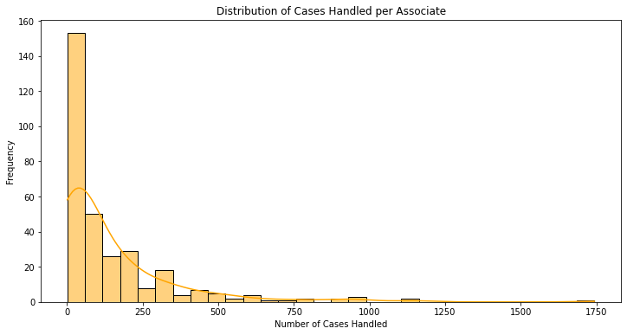
THROUGHPUT
& WORKLOAD BALANCE
DESCRIPTIVE STATISTICS:
Cases Handled Per Associate
Range: Max cases (1744) vs. min (1) highlights significant workload imbalance.
Mean: 146 Case per associate, with a high variance (standard deviation :218).
Median: 67 cases, much lower than the mean, shows a small group handles disproportionately high workloads.
Statistic | Value
Count | 318
Mean | 146.44
Std Dev | 218.26
Min | 1
Median | 67
Max | 1,744
OBJECTIVE:
To analyze the distribution of workload across associates.
RECOMMENDATION:
Redistribute Workload: Implement policies to evenly distribute cases among associates to reduce risk of burnout and ensure more consistent handling times.
Automated Workload Balancing: Consider workload management tools that dynamically adjust case assignments, optimizing for balanced distribution and enhanced productivity.
KEY INSIGHTS:
Uneven Distribution: A few associates handle significantly more cases (up to 1,744) compared to a median of 67, indicating workload imbalance.
Implications:
Risk of Burnout: Associates with heavy caseloads are at higher risk of fatigue, which can affect quality and accuracy.
Operational Inefficiency: An unbalanced workload can slow down processing times for complex cases and lead to inconsistent service quality.
Notes:
Histogram: The histogram displays the distribution of cases handled per associate, showing how most associates handle a relatively low number of cases, with a sharp decline as the case count increases. The curve overlaid on the histogram represents the distribution trend, indicating that a small subset of associates handles a disproportionately high workload. This imbalance suggests that while many associates manage fewer than 250 cases, a few handle significantly more, contributing to workload inconsistency across the team.

Slide 12
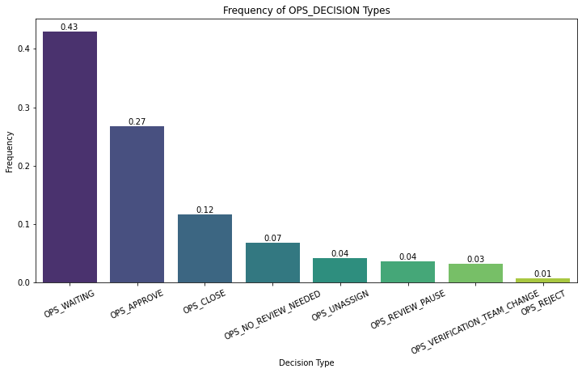
DECISION
CONSISTENCY
OBJECTIVE: To evaluate frequency of OPS_DECISION values to identify patterns in decision-making.
Decision Frequency Table
Decision Type | Frequency (%)
OPS_WAITING | 43%
OPS_APPROVE | 27%
OPS_CLOSE | 12%
OPS_NO_REVIEW_NEEDED | 7%
OPS_UNASSIGN | 4%
OPS_REVIEW_PAUSE | 4%
OPS_VERIFICATION_TEAM_CHANGE | 3%
OPS_REJECT | 1%
KEY INSIGHTS:
High OPS_WAITING (43%): Indicates a significant number of cases require further action or follow-up.
Top 3 Decisions: OPS_WAITING (43%), OPS_APPROVE (27%), OPS_CLOSE (12%).
IMPLICATION: Heavy reliance on OPS_WAITING suggests potential delays in resolution or ambiguity in decision-making criteria.
RECOMMENDATIONS:
Clearer Guidelines: Establish criteria for decisions to reduce follow-ups.
Training Programs: Improve associate efficiency in decision-making.

Slide 13
SUMMARY OF KEY OPERATIONAL HEALTH ANALYSIS
1. Processing Time Metrics:
High handling times for TYPE_THREE and TYPE_TWO cases indicate potential bottlenecks.
Wide handling time variation suggests inconsistencies in processing, possibly due to case complexity or associate experience levels.
2. Throughput & Workload Balance:
Uneven workload distribution across associates, with some handling up to 1,744 cases, while others handle far fewer.
This imbalance could lead to burnout and decreased performance for high-burden associates.
3. Decision Consistency:
Frequent OPS_WAITING decisions indicate that many cases are not fully resolved, likely due to a lack of clarity or support in decision-making processes.
Improving decision consistency may reduce follow-up cases and enhance operational flow.
Overall Operational Health Rating: Moderate – The team is performing adequately, but there are clear areas for improvement in handling efficiency, workload distribution, and decision consistency.

Slide 14
RECOMMENDATIONS: OPERATIONAL HEALTH ANALYSIS
1. Processing Time Improvements:
Standardize Processes for TYPE_TWO and TYPE_THREE cases to reduce handling time variability.
Additional Training: Equip associates with specific skills or guidance to manage complex cases more efficiently.
2. Workload Balance:
Redistribute Cases: Aim for a more balanced workload across associates to prevent burnout and maintain high-quality performance.
Automate Allocation: Implement workload management tools to dynamically assign cases more evenly.
3. Decision-Making Consistency:
Clearer Guidelines for Complex Decisions: Develop clearer criteria or decision pathways to reduce reliance on OPS_WAITING.
Ongoing Training: Offer refresher training for associates, focusing on improving decision accuracy and reducing incomplete cases.

Slide 15


CURRENT END CUSTOMER EXPERIENCE
How would you describe the current end customer experience taking into account our mission in Wise:
“Money without borders - instant, convenient, transparent and eventually free. We’re powering money for people and businesses: to pay, to get paid, to spend, in any currency, wherever you are, whatever you’re doing.”

Slide 16
OVERVIEW OF CURRENT END CUSTOMER EXPERIENCE.
Metric | Description | Python Code Used | Visualization
Total Resolution Time per Case | Measures the total time from case creation to final handling for each CASE_ID to assess processing efficiency. | max_end_times, min_start_times, resolution_times | Histogram
Average Handling Time by Case Type | Calculates the mean handling time for each CASE_TYPE to identify time requirements and bottlenecks. | avg_handling_time | Bar Chart
Decision-Making Consistency | Analyzes the frequency of OPS_DECISION types to evaluate decision consistency and identify potential delays. | decision_frequency | Bar Chart
Frequency of Repeat Reviews | Measures the number of reviews (PROCESSING_ID) per CASE_ID to identify cases needing multiple follow-ups. | repeat_reviews | Histogram
Workload Balance Among Associates | Examines the number of unique CASE_IDs handled by each associate (ACTOR_ID) to assess workload distribution. | cases_per_associate, workload_distribution | Histogram
Servicing and Corporate Overhead (incl. vendors)²

Slide 17
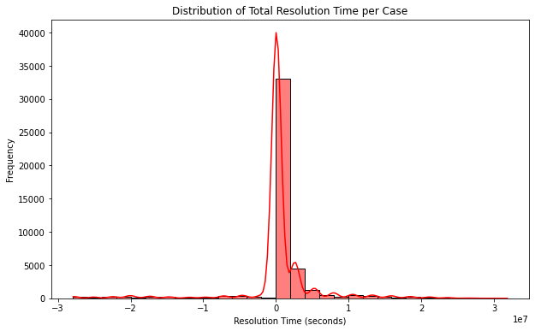
TOTAL RESOLUTION TIME PER CASE
Resolution Time Distribution (Histogram): The graph shows a concentration of cases with shorter resolution times but a long tail for cases with significant delays, indicating that a minority of cases contribute to high variance.
OBJECTIVE: Measure the overall time taken to resolve each CASE_ID from its start (CASE_CREATED_TIME) to finish (HANDLING_TIME_END), to assess processing speed and alignment with Wise's goal for instant, convenient service.
KEY INSIGHTS
Mean Resolution Time: 377,993 seconds (~4.4 days) per case, suggesting moderate delays in case resolution.
High Variance: Standard deviation of ~5.4 million seconds (~62 days), shows a large differences in resolution times and a maximum of ~31.8 million seconds (~1 year).
Implication: Large variance highlights inconsistencies, with some cases facing extreme delays, potentially harming customer experience
OUTPUT METRICS:
Statistic | Value (seconds)
Count | 44,074
Mean | 377,993
Std Dev | 5,395,918
Min | -27,904,800
25% | 1,740
Median | 20,220
75% | 342,420
Max | 31,833,300
CONCLUSION
Improving resolution time consistency across CASE_IDs would align Wise’s operations more closely with its mission for fast and efficient service.
Notes:
Histogram: Resolution time Distribution:- The histogram in this slide illustrates the **distribution of total resolution times** for each case, indicating how long cases typically take to be resolved. Most cases are resolved relatively quickly, as evidenced by the high concentration of data points toward the left side of the graph. However, there is a **long tail** extending to the right, representing a smaller number of cases that experience significantly extended resolution times.
The **red line** overlayed on the histogram is a density curve, smoothing out the distribution to highlight patterns more clearly. This curve accentuates the peak of frequently occurring resolution times but also draws attention to the minority of cases that have outlier delays. These outliers likely contribute to the **high standard deviation** and variance observed in the data, underscoring operational inconsistencies that could impact customer satisfaction due to unpredictable resolution times.

Slide 18
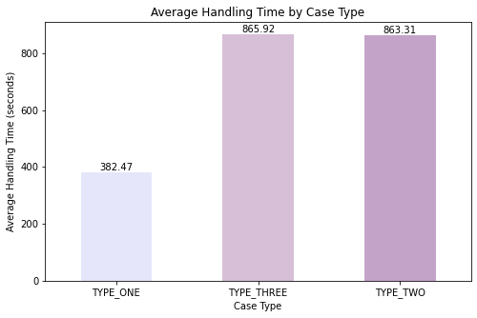
AVERAGE HANDLING TIME PER CASE TYPE
Average Handling Time by Case Type (Bar Chart):
Highlights the discrepancy in handling times, with TYPE_THREE and TYPE_TWO cases requiring significantly more time than TYPE_ONE.
OBJECTIVE: Analyze CASE_TYPE to understand the average time associates spend on different case types (TYPE_ONE, TYPE_TWO, TYPE_THREE) and identify any bottlenecks or inefficiencies.
KEY INSIGHTS
TYPE_ONE: 382 seconds on average, indicating relatively efficient handling.
TYPE_THREE: 866 seconds, and TYPE_TWO: 863 seconds, both showing significantly higher handling times than TYPE_ONE.
Implication: The longer handling times for TYPE_THREE and TYPE_TWO suggest complexity or inefficiencies for these case types, which may slow down processing and impact customer satisfaction.
OUTPUT METRICS:
Case Type | Mean: Average Handling Time (sec)
TYPE_ONE | 382
TYPE_THREE | 866
TYPE_TWO | 863
CONCLUSION
Reducing handling times for TYPE_THREE and TYPE_TWO could help Wise deliver more consistent service, aligning better with their goal for efficiency.

Slide 19
DECISION
MAKING CONSISTENCY
KEY INSIGHTS:
Most Frequent Decision: OPS_WAITING (43%), followed by OPS_APPROVE (27%) and OPS_CLOSE (12%).
Implication: A high frequency of OPS_WAITING decisions suggests a backlog or delays in decision-making, which could lead to prolonged resolution times and negatively impact customer experience.
Decision Type | Frequency (%)
OPS_WAITING | 43%
OPS_APPROVE | 27%
OPS_CLOSE | 12%
OPS_NO_REVIEW_NEEDED | 7%
OPS_UNASSIGN | 4%
OPS_REVIEW_PAUSE | 4%
OPS_VERIFICATION_TEAM_CHANGE | 3%
OPS_REJECT | 1%
OBJECTIVE:
To evaluate frequency of OPS_DECISION values to identify patterns in decision-making.
Decision Frequency (Bar Chart): Emphasizes that OPS_WAITING is the most common decision, indicating potential delays or indecision in the process.
CONCLUSION:
Addressing the high OPS_WAITING rate by providing clearer decision-making guidelines could improve consistency and speed, enhancing Wise’s commitment to streamlined operations.

Slide 20
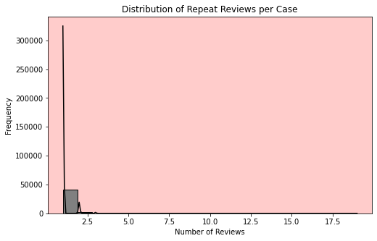
FREQUENCY OF
REPEAT REVIEW CASES
Repeat Reviews Distribution (Histogram): Most cases have only one review, but some cases with multiple reviews highlight potential inefficiencies or complex issues.
Statistic | Value
Count | 44,074
Mean | 1.07
Std Dev | 0.39
Min | 1
25% | 1
Median | 1
75% | 1
Max | 19
OBJECTIVE:
Count the number of reviews (PROCESSING_IDs) for each CASE_ID to assess the frequency of repeat handling and identify inefficiencies in the review process.
KEY INSIGHTS:
Average Repeat Reviews: 1.07 per case, indicating that most cases are resolved in a single review. However, a maximum of 19 reviews was observed for some cases, suggesting inefficiencies or complex cases requiring multiple follow-ups.
Implications:
Cases with high repeat reviews could indicate complex issues or inefficiencies in the review process, potentially leading to delays in final resolution.
CONCLUSION:
Reducing repeat reviews through process improvements could enhance operational efficiency and contribute to a better customer experience.
Notes:
Histogram: Distribution of Repeat Review per case:- The histogram highlights the distribution of repeat reviews per case. The vast majority of cases have only one review, as indicated by the tall bar at "1" on the x-axis, with a mean of 1.07 reviews per case. However, there are notable outliers, with some cases undergoing up to 19 reviews, shown as the few bars stretching towards the right of the histogram.

Slide 21
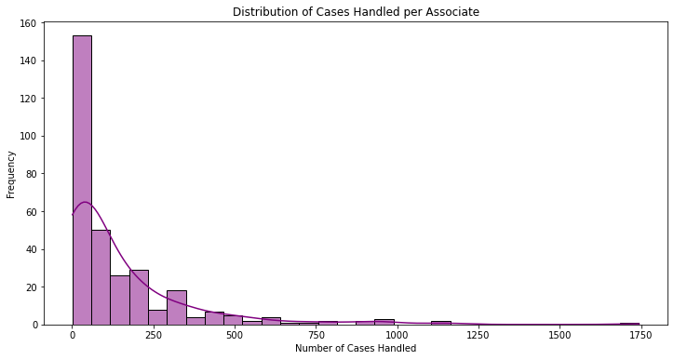
WORKLOAD
BALANCE AMONG ASSOCIATES
Distribution of Cases Handled per Associate (Histogram): The histogram shows a heavy right skew, with a small number of associates handling significantly more cases than others.
Statistic | Value
Count | 318
Mean | 146.44
Std Dev | 218.26
Min | 1
Median (50%) | 67
Max | 1,744
OBJECTIVE:
Examine the ACTOR_ID column to analyze the distribution of cases across associates, ensuring balanced workloads and consistent service.
KEY INSIGHTS:
Uneven Distribution: A few associates handle significantly more cases (up to 1,744) compared to a median of 67, indicating workload imbalance.
Mean Cases per Associate: 146 cases, but high standard deviation (218) and extreme values (min: 1 case, max: 1,744 cases) suggest significant workload imbalances.
Implications:
Some associates handle a disproportionately high caseload, risking fatigue, decreased quality, and potential burnout, which could impact customer experience and operational stability.
CONCLUSION:
Balancing workloads more evenly across associates could improve consistency, reduce burnout, and align Wise’s operations with its commitment to quality service.

Slide 22
SUMMARY OF CURRENT END CUSTOMER EXPERIENCE
1. Total Resolution Time per Case
High resolution time variance indicates potential processing inefficiencies.
Extended resolution times for certain cases may negatively impact customer satisfaction.
2. Average Handling Time by Case Type
Type-based handling time variability suggests complexity differences among case types.
Cases like TYPE_THREE take longer, indicating a need for optimized handling strategies.
3. Decision-Making Consistency
High frequency of OPS_WAITING decisions suggests delays in resolution.
Inconsistent decision patterns highlight areas for improved training or guidance.
4. Frequency of Repeat Reviews
Cases with multiple reviews signal inefficiencies in the initial resolution process.
Reducing repeat reviews can improve processing efficiency and reduce rework.
5. Workload Balance Among Associates
Significant workload disparities exist across associates, leading to possible burnout.
More balanced case distribution is needed to ensure consistent performance and efficiency.
Overall Current End Customer Experience Rating: Moderate
While there are areas of efficiency and decision-making that meet acceptable standards, significant variability in resolution times, workload imbalances, and frequent delays due to OPS_WAITING decisions indicate room for improvement to enhance consistency and responsiveness in customer experience.

Slide 23
RECOMMENDATIONS: CURRENT END CUSTOMER EXPERIENCE
1. Total Resolution Time per Case
Streamline processes for complex cases and investigate bottlenecks to reduce extended resolution times, improving customer satisfaction.
2. Average Handling Time by Case Type
Provide specialized training or resources for associates handling time-intensive cases like TYPE_THREE to enhance efficiency.
3. Decision-Making Consistency
Implement clearer guidelines and support for associates to reduce the frequency of OPS_WAITING decisions, ensuring quicker and more consistent resolutions.
4. Frequency of Repeat Reviews
Strengthen initial review protocols to minimize the need for repeat reviews, thereby reducing rework and improving processing efficiency.
5. Workload Balance Among Associates
Redistribute cases more evenly among associates to prevent burnout and maintain consistent service quality across the team.

Slide 24

AGENT PERFORMANCE & EFFICIENCY RED FLAGS
What kind of red flags do you identify in either of the following aspects:
a.) Agent performance b.) Efficiency
24

Slide 25
OVERVIEW OF AGENT PERFORMANCE & EFFICIENY RED FLAGS.
Metric | Description | Python Code Used | Visualization
Cases Handled per Associate | Number of unique CASE_IDs handled by each ACTOR_ID to assess workload distribution. | cases_per_associate, workload_distribution | Histogram
Average Handling Time by Case Type | Mean handling time per associate, identifying productivity and training needs. | avg_handling_time_per_associate | Histogram
Decision-Making Consistency | Frequency of OPS_WAITING decisions per associate to identify need for decision support. | waiting_cases_per_associate, waiting_percentage | Histogram
Repeat Review Rate | Number of reviews per CASE_ID to find cases needing multiple follow-ups, indicating inefficiencies. | repeat_reviews | Histogram
Resolution Time Variability | Variability in total resolution time for each CASE_ID to highlight cases with prolonged durations. | max_end_times, min_start_times, resolution_times | Histogram
Average Resolution Time by Case Type | Average resolution time per CASE_TYPE to identify cases that need specialized handling. | resolution_time_by_case_type | Bar Chart
Servicing and Corporate Overhead (incl. vendors)²

Slide 26
AGENT PERFORMANCEANALYSIS
3.1

Slide 27
CASES
HANDLED PER ASSOCIATES
Distribution of Cases Handled per Associate (Histogram): The histogram shows a heavy right skew, with a small number of associates handling significantly more cases than others.
Statistic | Value
Count | 318
Mean | 146.44
Std Dev | 218.26
Min | 1
Median (50%) | 67
Max | 1,744
OBJECTIVE:
Evaluate workload distribution among associates, using ACTOR_ID and CASE_ID to identify potential imbalances.
RED FLAG:
The high case count for some associates suggests a workload imbalance. Associates handling a high number of cases may face burnout, while those with lower counts may be underutilized, affecting both service quality and morale.
KEY INSIGHTS:
Range: Associates handle between 1 and 1744 cases.
Mean Cases per Associate: 146 cases, but high standard deviation (218) and extreme values (min: 1 case, max: 1,744 cases) suggest significant workload imbalances.
CONCLUSION/RECOMMENDATION:
Redistribute cases more evenly across associates to prevent burnout and improve overall team efficiency.

Slide 28
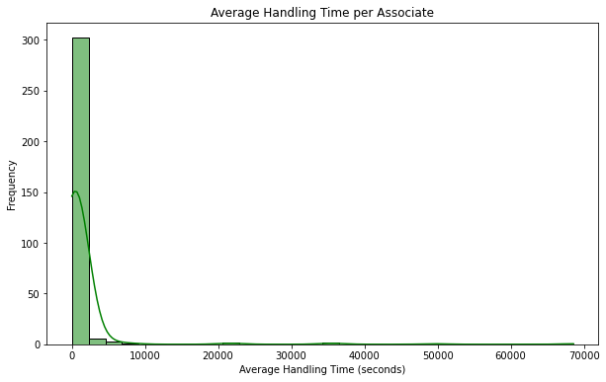
AVERAGE HANDLING TIME PER ASSOCIATE
Avg. Handling Time per Associate (Histogram): Histogram displaying a wide range of handling times, with a concentration of higher values on the upper end.
Statistic | Value (sec)
Count | 318
Mean | 1316.5
Std Dev | 5726.9
Min | 0.0
Median (50%) | 443.6
Max (100%) | 68557.3
OBJECTIVE:
Assess individual efficiency by calculating the average handling time for each associate based on HANDLING_TIME_START and HANDLING_TIME_END.
KEY INSIGHTS:
Mean handling time: 1316.5 seconds, with a high standard deviation of 5726.9 seconds.
Max handling time: 68557.3 seconds, indicating some associates are taking significantly longer on certain cases.
RED FLAG:
Associates with unusually high handling times may lack proficiency or face difficulties with certain cases, impacting productivity and service consistency.
CONCLUSION/RECOMMENDATION:
Provide targeted training to associates with high handling times, focusing on efficiency improvements in handling complex cases.
Notes:
Histogram: Avg. Handling Time per Associate :- The histogram displays the distribution of average handling times per associate, showing a significant concentration of associates with lower handling times on the left side of the chart. Most associates handle cases in a relatively short time, as indicated by the tall bar at the beginning of the x-axis.
The green line overlaid on the histogram represents a density plot, which helps to visualize the spread and distribution of handling times more smoothly. This line shows that while most associates have low to moderate handling times, there are a few outliers with exceptionally high handling times, extending far to the right. This indicates that some associates are taking substantially longer to handle certain cases, which could suggest challenges in efficiency or proficiency among a subset of the team.

Slide 29
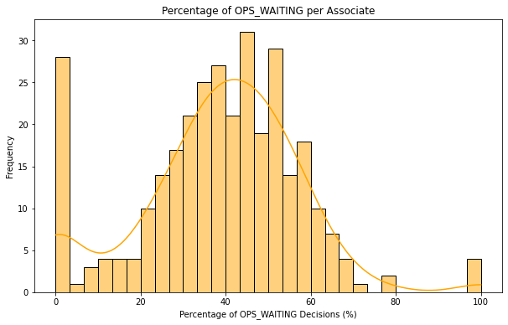
DECISION CONSISTENCY (OPS WAITING)
Percentage of Ops Waiting Per Associate (Histogram): Histogram showing the distribution of OPS_WAITING decisions per associate, with some associates relying heavily on this option.
Statistic | Value
Mean | 38.6%
Std Dev | 18.8%
Min | 0
Max | 100%
OBJECTIVE:
Identify associates who frequently mark cases as OPS_WAITING using the OPS_DECISION field, to understand delays in decision-making.
RED FLAG:
High OPS_WAITING rates for certain associates suggest indecision or lack of confidence, causing delays and inefficient case handling.
KEY INSIGHTS:
Average percentage of OPS_WAITING decisions: 38.6%, with some associates marking 100% of cases as OPS_WAITING.
Wide variability indicates that some associates are heavily reliant on OPS_WAITING, potentially delaying resolutions.
Ops_Waiting % per Associate:
ACTOR_ID | Value
451 | 37.13
455 | 33.91
458 | 23.41
461 | 33.56
CONCLUSION/RECOMMENDATION:
Provide enhanced decision-making guidelines with high OPS_WAITING rates to improve resolution speed and reduce backlog.
Notes:
Histogram: Percentage of Ops Waiting Per Associate :- The histogram in the slide illustrates the distribution of the percentage of **OPS_WAITING** decisions across associates, showing how frequently associates mark cases as "waiting" rather than making an immediate decision. The high variability in OPS_WAITING rates, as shown by the broad range of values from 0% to 100%, suggests that some associates consistently rely on OPS_WAITING, while others rarely use it.
The **orange density curve** overlaid on the histogram provides a smoother representation of the distribution, indicating a peak around 40%, where many associates fall. This curve highlights the spread and frequency of different OPS_WAITING percentages, with outliers at both extremes. Some associates display unusually high dependency on OPS_WAITING, pointing to possible decision-making challenges or a lack of confidence in resolving cases immediately, leading to potential delays in case handling.

Slide 30
SUMMARY: RED FLAGS IN AGENT PERFORMANCE ANALYSIS
1. Cases Handled per Associate
Significant disparity in the number of cases handled by associates, with some carrying an excessive workload.
Imbalanced distribution raises concerns about burnout risk and potential declines in service quality and consistency.
2. Average Handling Time by Case Type
Variability in handling times across different case types indicates differences in case complexity and associate familiarity.
High average handling times for certain case types suggest inefficiencies and highlight a need for additional training or process improvements.
3. Decision-Making Consistency (OPS_WAITING)
High reliance on OPS_WAITING decisions among certain associates points to delays and potential indecision in processing.
Inconsistent decision patterns reveal a need for better guidance and structured support to help associates make timely and effective decisions.
Overall Rating for Agent Performance Analysis: Moderate
While the team demonstrates adequate handling capabilities, significant inconsistencies in workload distribution, handling times, and decision-making highlight areas that need improvement. Addressing these gaps will enhance productivity, reduce burnout risk, and ensure more consistent performance across the team.

Slide 31
OPERATIONAL EFFICIENCY ANALYSIS
3.2

Slide 32
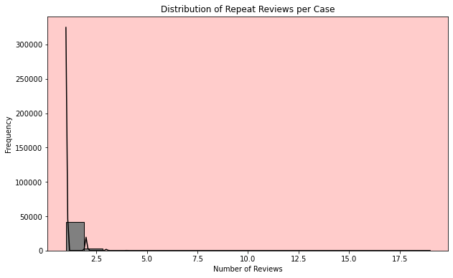
FREQUENCY OF
REPEAT REVIEW CASES
Repeat Reviews Distribution (Histogram): Most cases have only one review, but some cases with multiple reviews highlight potential inefficiencies or complex issues.
Statistic | Value
Count | 44,074
Mean | 1.07
Std Dev | 0.39
Min | 1
Median (50%) | 1
Max | 19
OBJECTIVE:
Evaluate how often cases are reviewed multiple times, using CASE_ID and PROCESSING_ID fields to detect inefficiencies in first-time resolutions
KEY INSIGHTS:
Average Repeat Reviews: 1.07 per case, indicating that most cases are resolved in a single review. However, a maximum of 19 reviews was observed for some cases, suggesting inefficiencies or complex cases requiring multiple follow-ups.
CONCLUSION/RECOMMENDATION:
Strengthen initial review protocols to improve resolution accuracy, reducing the need for follow-up reviews.
RED FLAG:
A repeat review rate above a certain threshold may point to process inefficiencies, where cases are not fully resolved on the first attempt, leading to rework and increased resolution times.
Notes:
Histogram: Distribution of Repeat Review per case:- The histogram highlights the distribution of repeat reviews per case. The vast majority of cases have only one review, as indicated by the tall bar at "1" on the x-axis, with a mean of 1.07 reviews per case. However, there are notable outliers, with some cases undergoing up to 19 reviews, shown as the few bars stretching towards the right of the histogram.

Slide 33
RESOLUTION TIME VARIABILITY
Resolution Time Variability (Histogram): The graph shows a concentration of cases with shorter resolution times but a long tail for cases with significant delays, indicating that a minority of cases contribute to high variance.
Statistic | Value (seconds)
Count | 44,074
Mean | 377,993
Std Dev | 5,395,918
Min | -27,904,800
Median (50%) | 20,220
Max | 31,833,300
OBJECTIVE:
Analyze the spread of resolution times across cases to identify bottlenecks or inconsistencies, using CASE_CREATED_TIME and HANDLING_TIME_END.
KEY INSIGHTS:
Mean Resolution Time: 377,993 seconds (~4.4 days) per case, suggesting moderate delays in case resolution.
High Variance: Standard deviation of ~5.4 million seconds (~62 days), shows a large differences in resolution times and a maximum of ~31.8 million seconds (~1 year).
Extreme values: Some cases take excessively long, possibly due to complex cases or process inefficiencies.
RED FLAG:
Cases with significantly extended resolution times may point to bottlenecks or complex issues that are not handled efficiently. This could negatively impact customer experience, particularly for cases with repeated delays.
CONCLUSION:
Investigate causes for extended resolution times and consider streamlining processes for complex cases to reduce overall variability.
Notes:
Histogram: Resolution time Distribution:- The histogram in this slide illustrates the **distribution of total resolution times** for each case, indicating how long cases typically take to be resolved. Most cases are resolved relatively quickly, as evidenced by the high concentration of data points toward the left side of the graph. However, there is a **long tail** extending to the right, representing a smaller number of cases that experience significantly extended resolution times.
The **red line** overlayed on the histogram is a density curve, smoothing out the distribution to highlight patterns more clearly. This curve accentuates the peak of frequently occurring resolution times but also draws attention to the minority of cases that have outlier delays. These outliers likely contribute to the **high standard deviation** and variance observed in the data, underscoring operational inconsistencies that could impact customer satisfaction due to unpredictable resolution times.

Slide 34
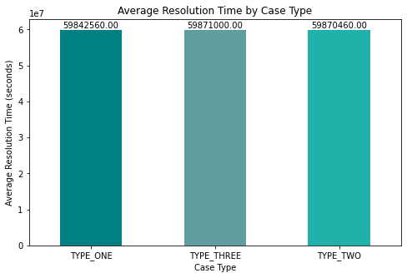
AVERAGE RESOLUTION
TIME BY
CASE TYPE
Average Resolution Time by Case Type (Bar Chart): Bar chart illustrating average resolution time by case type, with TYPE_THREE cases taking the longest.
Case Type | Average Resolution Time (sec)
TYPE ONE | 59,842,560
TYPE TWO | 59,870,460
TYPE THREE | 59,871,000
OBJECTIVE:
Identify case types that take longer to resolve on average, using CASE_TYPE to target potential bottlenecks.
KEY INSIGHTS:
TYPE_THREE cases show the longest resolution times, potentially due to complexity.
Resolving complex case types more efficiently could improve overall team productivity.
CONCLUSION/RECOMMENDATION:
Provide specialized training for associates handling time-intensive cases like TYPE_THREE to improve efficiency.
RED FLAG:
Longer resolution times for specific case types, especially TYPE_THREE, indicate that these cases may be more complex and require additional resources.

Slide 35
SUMMARY: RED FLAGS IN OPERATIONAL EFFICIENCY ANALYSIS
1. Repeat Review Rate
High frequency of cases requiring multiple reviews highlights inefficiencies in initial resolutions, suggesting that cases are not being effectively resolved on the first attempt.
This pattern indicates rework and delays, reducing overall operational efficiency and potentially impacting customer satisfaction.
2. Resolution Time Variability
Significant variability in resolution times points to inconsistencies in case handling, with some cases taking much longer than others.
Cases with extended durations may indicate process bottlenecks, which could slow down operations and hinder the ability to meet service timelines.
3. Average Resolution Time by Case Type
Certain case types, such as TYPE_THREE, consistently show higher average resolution times, reflecting case complexity or associate challenges with these cases.
Extended times for specific case types suggest a need for targeted handling strategies or specialized training to improve efficiency.
Overall Rating for Operational Efficiency Analysis: Moderate
While basic efficiency is maintained, high repeat review rates, variable resolution times, and longer handling times for complex cases suggest underlying inefficiencies. Addressing these areas will enhance processing speed, consistency, and the ability to meet customer expectations effectively.

Slide 36
CAPACITY PLANNING: OPERATIONAL READINESS FOR A 5X WORKLOAD INCREASE
What would you suggest? Feel free to take a creative approach. It’s important not to come up with a concrete date but rather to explain your thought process around how would you approach this problem and how would you negotiate with the growth team.
What kind of concerns would you have? What kind of extra information would you require from the growth team prior to the new product launch?

Slide 37
CAPACITY PLANNING FOR A 5X WORKLOAD INCREASE FOR TYPE_THREE CASES
Metric | Description | Python Code Used | Visualization
Assessing Current Capacity for TYPE_THREE Cases | Measures current average number of TYPE_THREE cases handled per associate to set a baseline for scaling. | cases_per_associate_january, january_data | Summary Table
Required Cases per Associate for 5x Increase | Calculates estimated cases per associate for a 5x workload increase. | workload_increase_factor, estimated_cases_per_associate | Bar Chart
Required Team Size after 5x Workload Increase | Determines the required team size to handle a 5x workload while maintaining January 2022 standards. | current_type_three_team_size, required_team_size | Bar Chart
Additional Associates and Timeline Estimation | Calculates additional associates needed and estimates the timeline for hiring and onboarding. | additional_associates_needed, total_time_per_new_hire | Horizontal Bar Chart of Hiring Stages
Servicing and Corporate Overhead (incl. vendors)²

Slide 38
APPROACH TO ASSESSING AND SCALING OPERATIONAL CAPACITY
Analytical Approach:
1. Establishing Baseline Capacity:
I began by determining the average workload each associate handled for TYPE_THREE cases in January 2022, using this as a baseline for scaling.
Code Explanation:
I filtered the data specifically for TYPE_THREE cases handled in January 2022.
By grouping cases by ACTOR_ID and counting unique CASE_IDs, I calculated the average number of cases handled per associate.
2. Calculating Required Capacity for a 5x Workload Increase:
Using the baseline, I estimated the increased workload each associate would face if the volume scaled to 5x the current amount.
Step 2.1 - Estimating Required Cases per Associate:
I multiplied the baseline average cases per associate by a factor of 5 to project the expected workload each associate would need to handle under the new demand.
Step 2.2 - Estimating Required Team Size:
I then calculated the required number of associates needed to maintain the January 2022 performance standards.
By multiplying the current TYPE_THREE team size by the 5x workload factor, I determined the expanded team size necessary to handle the increased workload without compromising efficiency.
Conclusion:
This approach allows for a clear forecast of resource needs and enables proactive planning for potential hiring or workload redistribution. By using baseline metrics and scaling calculations, I was able to outline the specific team size and individual workload required to meet the anticipated demand increase while maintaining service standards.
8

Slide 39
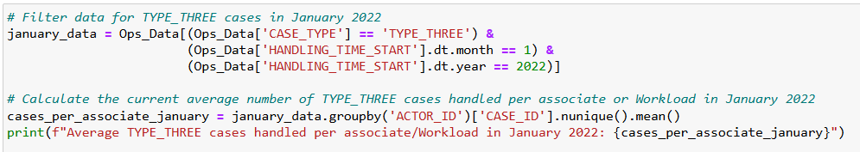
ASSESSING CURRENT CAPACITY FOR TYPE_THREE CASES
Python Code: Determining TYPE_THREE Cases in January 2022
Output Summary Table
Metric | Value
Current TYPE_THREE Cases per Associate | 23.97 (~24)
OBJECTIVE:
To establish the current workload capacity of TYPE_THREE cases handled per associate in January 2022 as a baseline for scaling.
KEY INSIGHTS:
Baseline Workload: In January 2022, each associate handled an average of ~24 TYPE_THREE cases.
This average will serve as the basis for estimating capacity requirements for a 5x increase in workload.
CONCLUSION:
The current handling capacity (24 cases per associate) will be used to estimate the team size needed for increased workload.

Slide 40
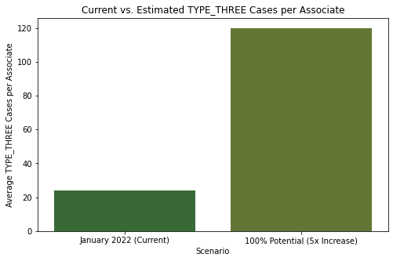
ESTIMATING REQUIRED
CAPACITY FOR A 5X WORKLOAD INCREASE
Current vs. Estimated TYPE_THREE cases per associate (Bar Chart): Demonstrates the substantial increase in workload each associate would face
Scenario | Avg. Cases Per Associate
Current (Jan 2022) | 23.97 (~24)
Required (5x Increase) | 119.87 (~120)
Metric 1: REQUIRED CASES PER ASSOCIATE FOR 5X INCREASE
KEY INSIGHTS:
Current Average: 24 cases per associate in January 2022.This average will serve as the basis for estimating capacity requirements for a 5x increase in workload.
Required Capacity: Associates would need to handle approximately 120 cases per month under a 5x workload scenario.
OBJECTIVE:
Calculate the increased number of cases each associate would need to handle to meet the 5x workload.
CONCLUSION:
A 5x workload increase would significantly raise each associate’s case volume, requiring either increased productivity or additional resources.
Notes:
Box Plot: Handling time Distribution by Case Types:-

Slide 41
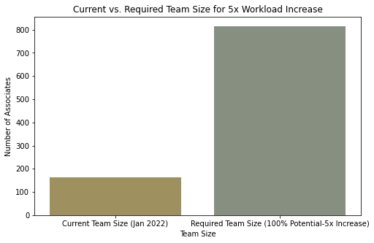
ESTIMATING REQUIRED
CAPACITY FOR A 5X WORKLOAD INCREASE
Current vs. Required TEAM_SIZE (Bar Chart): Highlights the large increase in team size needed to meet the 100% increase in workload demand.
Metric | Value
Current TYPE_THREE Team | 163
Required Team Size (5x) | 815
Metric 2: REQUIRED TEAM SIZE FOR 5X INCREASE
KEY INSIGHTS:
Current Team Size: 163 associates handling TYPE_THREE cases in January 2022.
Required Team Size: To meet the 5x increase, approximately 815 associates would be necessary.
OBJECTIVE:
Calculate the number of associates needed to handle the increased workload while maintaining the January 2022 processing standards.
CONCLUSION:
Scaling up to 815 associates is necessary to manage the expected workload while maintaining existing performance standards.
Notes:
Box Plot: Handling time Distribution by Case Types:-

Slide 42
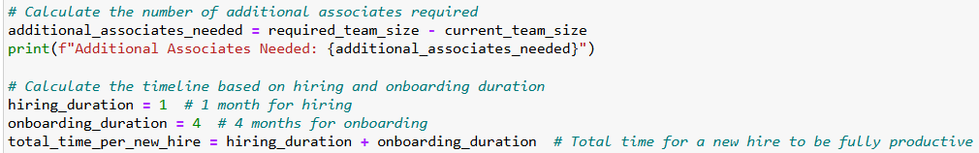
APPROACH TO ESTIMATING REQUIRED TEAM EXPANSION & TIMELINE
Analytical Approach:
1. Establishing Baseline Team Size:
Using January 2022 data as a reference, I calculated the current team size and capacity for TYPE_THREE cases. This provides a benchmark to assess the required expansion.
2. Calculating Additional Associates Needed:
Based on the 5x workload increase, I estimated the total required team size and identified the gap between the current team size and the target.
3. Estimating Timeline for Hiring and Onboarding:
Each new hire requires a 1-month hiring period followed by 4 months of onboarding to reach full productivity. Thus, each associate will need a total of 5 months from hiring initiation to be fully prepared for operational duties. Assuming all hires are brought in concurrently, this timeline allows for optimal planning and scaling without overextending resources.
Code Explanation:
Calculate Additional Associates: Determines the additional associates needed by subtracting the current team size from the required team size.
Define Onboarding Timeline: Sets hiring (1 month) and onboarding (4 months) durations, totaling 5 months per new hire.
Output Total Time for Full Productivity: Calculates the full 5-month timeline for each associate to be fully ready

Slide 43
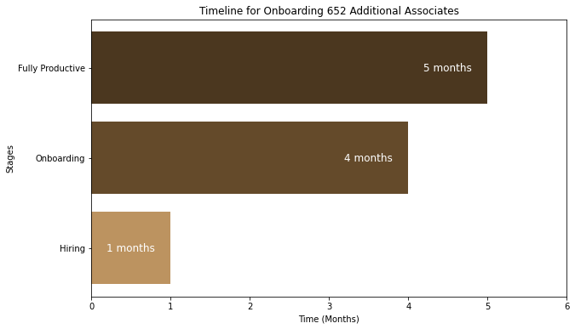
CALCULATING ADDITIONAL ASSOCIATES
& ESTIMATING TOTAL TIME REQUIRED
Visual Figure: Horizontal bar chart showing stages of hiring, onboarding, and full productivity.
Explanation: Visualizes the 5-month timeline for new hires to reach full productivity.
OBJECTIVE:
Determine the additional associates required and estimate the time required to fully onboard these associates to manage the 5x workload increase.
KEY INSIGHTS:
Additional Associates Needed: 652 additional associates are required to reach the total team size of 815.
Timeline: Each new hire requires a 5-month preparation period (1 month hiring + 4 months onboarding) to become fully productive.
Requirement | Value
Additional Associates Needed | 652
Time to Full Productivity | 5 Months
CONCLUSION:
It would take approximately 5 months from the start of hiring to have new associates fully productive and ready to handle the increased workload.

Slide 44
SUGGESTIONS!!
NEGOTIATION APPROACH WITH THE GROWTH TEAM:
Phased Rollout Request: I’ll propose a gradual rollout instead of an immediate 5x increase. This phased approach will allow us to monitor capacity adjustments in real-time, helping to mitigate potential service delays.
Alignment on Training Needs: I’ll emphasize the importance of dedicating resources to training new hires, so they reach optimal productivity faster and can handle the increased workload efficiently.
Discuss Performance Metrics: I’ll suggest setting mutually agreed-upon KPIs for service standards during this transition, ensuring alignment on expectations for service consistency.
Pilot Phase Option: I’ll propose launching a pilot phase with a smaller customer segment to test our operational scalability. This will provide insights into real demand, allowing us to adjust the hiring timeline if needed.
MY KEY CONCERNS:
Hiring and Training Timeline: I’ll emphasize that any delays in hiring or onboarding could impact our readiness, potentially straining existing resources.
Quality Control: Maintaining service standards will be essential. I’ll stress the need for consistent quality checks to avoid performance dips during the transition.
Impact on Existing Team: There’s a risk that current associates may experience an increased workload during onboarding. I’ll highlight the importance of managing this to support morale and maintain efficiency.
Process Optimization: While we’ll need additional headcount, I’ll advocate for exploring process improvements to enhance handling times and reduce our long-term reliance on a large workforce.
ADDITIONAL INFORMATION FROM THE GROWTH TEAM:
Projected Demand Timeline: I’ll ask for clarity on when the team expects to reach the full 5x workload, allowing us to plan hiring phases with precision
Flexibility in Rollout Scale: I’ll determine if phased scaling is an option, as this could alleviate immediate capacity pressures and enable a more controlled ramp-up.
Customer Experience Standards: I’ll request specific service quality metrics so we can tailor training and performance tracking to meet these expectations.
Feedback Mechanism: Post-launch, I’ll suggest implementing a feedback loop to quickly identify challenges and refine our processes as needed.

Slide 45
SUMMARY: OPERATIONAL READINESS FOR TYPE_THREE WORKLOAD INCREASE
1. Current Capacity for TYPE_THREE Cases
Average of 24 cases handled per associate in January 2022 establishes the baseline.
This baseline helps project the increased resources required to handle a 5x workload.
2. Estimated Cases per Associate for 5x Increase
Associates would need to handle approximately 120 cases each to meet the increased demand.
This significant rise underscores the need for either enhanced efficiency or expanded resources.
3. Required Team Size for 5x Workload Increase
Current team of 163 associates for TYPE_THREE cases would need to scale up to 815 associates.
Highlights the necessity of substantial hiring to maintain the January 2022 processing standards.
Hiring and Onboarding Timeline for Additional Associates
652 additional associates required, with a 5-month period (1 month for hiring + 4 months for onboarding) to become fully productive.
Provides a timeline to reach full operational capacity after new hiring begins.
Overall Operational Readiness Rating: Challenging
While current metrics provide a foundation for handling the projected workload increase, the substantial scaling of resources, significant training demands, and potential impact on existing team performance present operational challenges. A phased rollout, structured feedback loops, and continual monitoring are recommended to enhance readiness.

Slide 46
THANK YOU
46

Slide 47
Q&A
47

